Slide 1


EXPLORING THE
SAUDI ARABIAN -RIYADH
CAR MARKET

Slide 2

CONTENTS
1
INTRODUCTION
6
RELATIONSHIP BETWEEN MILEAGE AND PRICE
2
GOALS
7
CAR PRICES BY TRANSMISSION TYPE
3
DATA OVERVIEW
8
MEAN CAR PRICES BY COLOR
4
TRANSMISSION TYPE POPULARITY BREAKDOWN
9
PREDICTING
car prices in the next three years
5
USED VS. NEW CAR MARKET
10
SUMMARY
11
CONCLUSION

Slide 3

INTRODUCTION
This project aims to analyze the used and new car market in Saudi Arabia using a comprehensive dataset of car listings.
This can help consumers and dealers make better decisions.

Slide 4
GOALS:
See how many used and new cars are in the market, and how they are different.
Find the most popular car brands, models, fuel types, and transmission types.
Analyze car prices and what factors affect them.
See where in Saudi Arabia the cars are located.
Provide useful insights that can help people in the car market.

Slide 5

DATA OVERVIEW

Slide 6
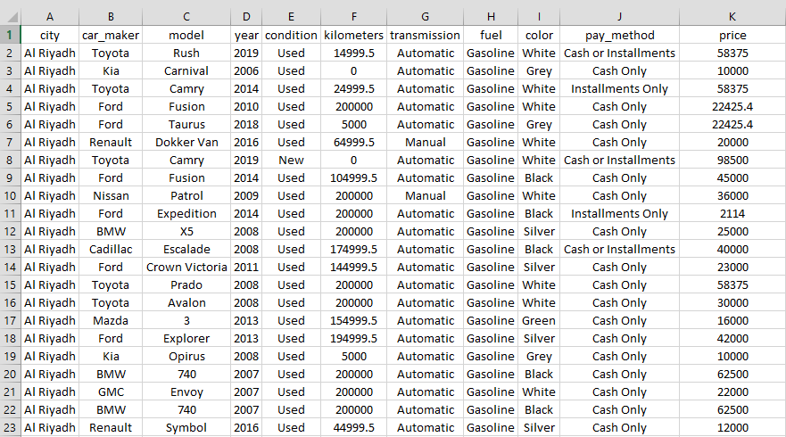

Slide 7
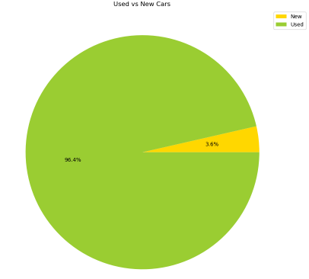
USED VS NEW CAR
We note that the majority of the database here is used cars. It is very likely that the data analyzes that I conducted are affected and influenced by used cars more than new ones.

Slide 8
TRANSMISSION TYPE POPULARITY BREAKDOWN

Slide 9

TOP 5 CAR MAKES AND MODELS:
BMW 740 (2007, Used)
BMW 730 (2014, Used)
Kia Rio (2015, Used
Toyota Rush (2019, Used)
Toyota Prado (2008, Used

Slide 10
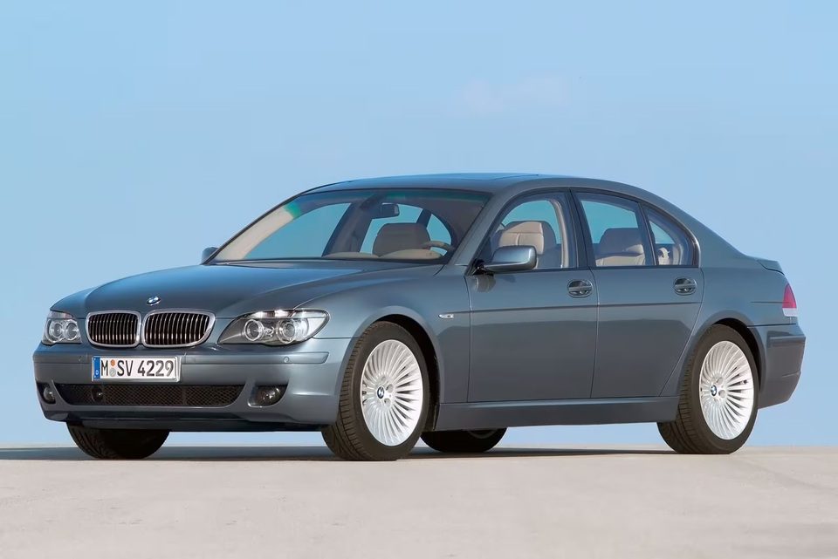

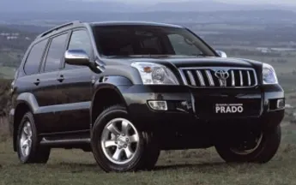
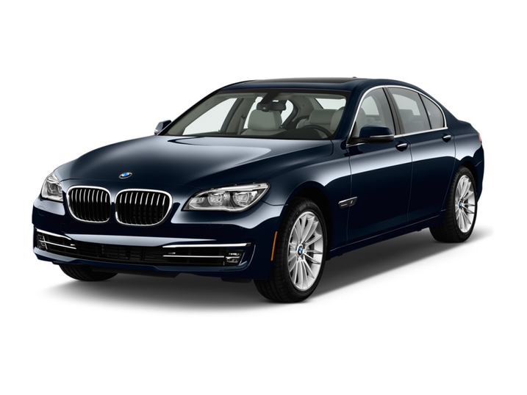
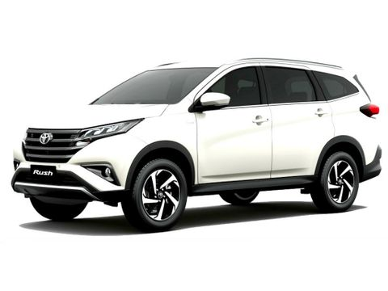
1
3
5
2
4

Slide 11
5 LEAST POPULAR CAR MAKES AND MODELS:
- BMW 730 (2014, Used)
- Toyota Prado (2008, Used
- Toyota Fortuner (2016, Used
- Toyota Camry (2019, New)
- Toyota Camry (2014, Used)

Slide 12
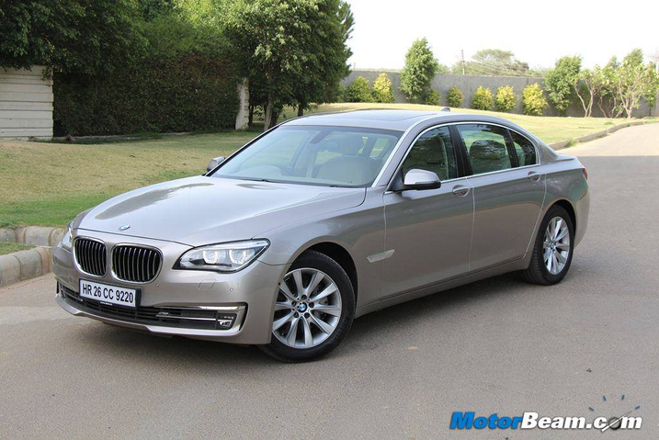
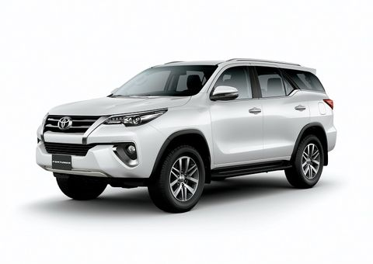
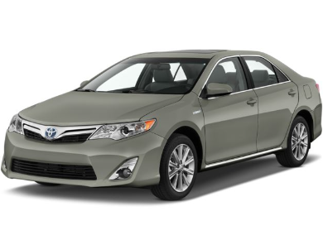
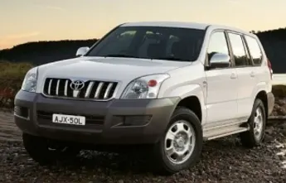
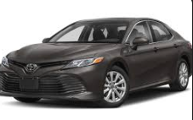
1
3
5
2
4

Slide 13
TRANSMISSION TYPE POPULARITY BREAKDOWN

Slide 14
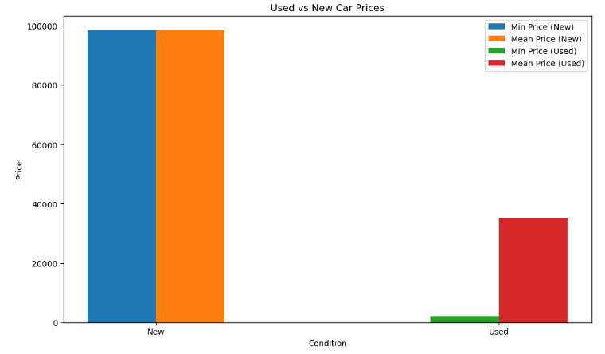
THE DIFFERENCE IN
NEW VS. USED
CAR PRICES
1. New cars are much more expensive than used cars.
- The minimum price for a new car is around 80,000 SR, while the minimum price for a used car is only around 22,000 SR.
- The average price for a new car is around 90,000SR, while the average price for a used car is only around 30,000SR.
2. The prices of used cars vary a lot more than new cars.
- The difference between the minimum and average price for used cars is around 8,000 SR.
- The difference between the minimum and average price for new cars is only around 10,000SR.
3. There is a big gap in prices between new and used cars.
- The minimum price for a new car (80,000 SR) is over 3 times higher than the minimum price for a used car (22,000 SR).
- The average price for a new car (90,000 SR) is almost 3 times higher than the average price for a used car (30,000 SR).
4. Buyers can save a lot of money by choosing a used car over a new one.
- The minimum price difference between new and used cars is around 58,000 SR.
- The average price difference between new and used cars is around 60,000 SR.

Slide 15
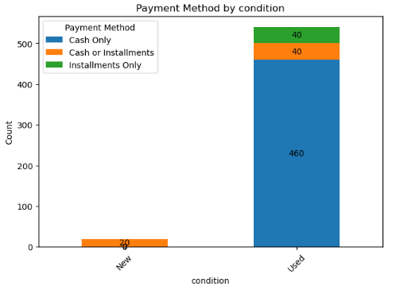
THE DIFFERENCE IN
NEW VS. USED
CAR PAYMENT METHOD
For "New" condition, the predominant payment method is "Cash or Installments
" with a count of around 460.
2.For "used" condition, the payment methods "Cash only" the most preferred method

Slide 16
RELATIONSHIP BETWEEN MILEAGE AND PRICE

Slide 17
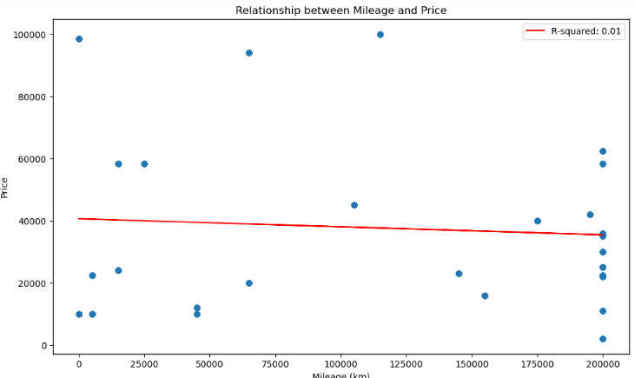
RELATIONSHIP BETWEEN MILEAGE AND PRICE
The graph shows a clear trend that as the mileage of a car increases, the price generally decreases. This inverse relationship between mileage and price

Slide 18
CAR PRICES BY TRANSMISSION TYPE

Slide 19
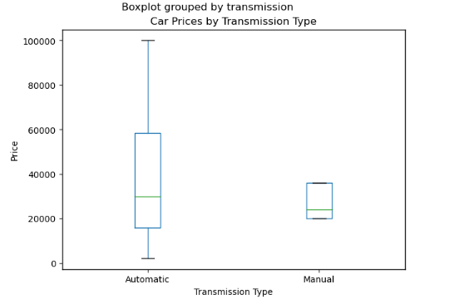
The median car price for Automatic transmission cars is around 75,000 SR, significantly higher than the median price of around 25,000 SR for Manual transmission cars.

Slide 20
MEAN CAR PRICES BY COLOR

Slide 21

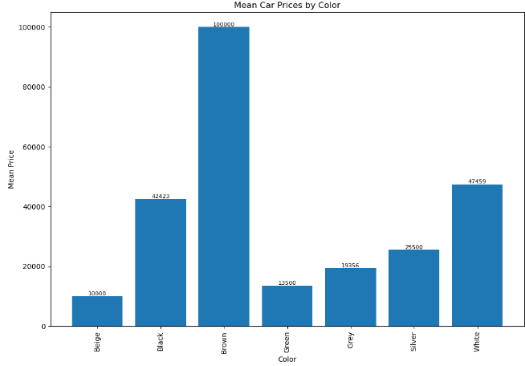
MEAN CAR PRICES BY COLOR
The highest mean car price is for the color "Brown" at around 90,000SR.
The second highest mean car price is for the color "Blue" at around 73,000SR.
The third highest mean car price is for the color "Silver" at around 65,000SR.
The lowest mean car price is for the color "Black" at around 65,000SR.
The mean car prices for the other colors (Gold, Gray, White) range from around $56,000 to 67,000SR.

Slide 22
PREDICTING
CAR PRICES IN THE NEXT THREE YEARS

Slide 23
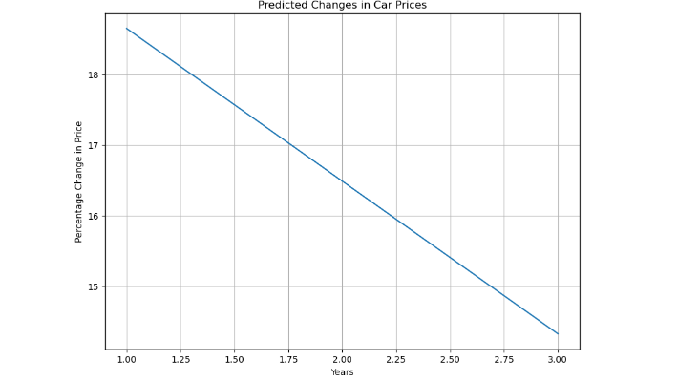
The chart shows that car prices are predicted to steadily decrease by 2% each year, going from an 18% price drop at 1 year to a 16% price drop at 3 years. For a car initially priced at 20,000SR, this would mean a price reduction of around 3,600SR in the first year and a total reduction of over 6,000SR by the third year, resulting in a final predicted price of around 13,776SR.

Slide 24
SUMMARY
The most popular car makes and models are BMW 740, BMW 730, Kia Rio, Toyota Rush, and Toyota Prado
Automatic transmission cars have a significantly higher median price (~75,000 SR) compared to manual (~25,000 SR)
New cars are much more expensive than used cars, with an average price difference of around 60,000 SR
Mileage has a strong inverse relationship with car prices, as expected
Colors like Brown, Blue, and Silver tend to have the highest mean car prices
Car prices are predicted to steadily decrease by 2% per year over the next 3 years

Slide 25
CONCLUSION
This car dataset is scrapped from (sa.opensooq.com) a Saudi second-hand market platform The link of data set on kaggle : Saudi Arabia car prices Machine Learning.

